Slide 1
INFORMATION ENCODING STANDARDS-02
BDAT-1001
FINAL PROJECT PART-1
Submitted By: MADHURI SHARMA
Student ID: 200460001
Time-Table : B

Slide 2
TASKS TO DO
Create ASP.Net core web application
Build a secure ASP.NET Core API
Add your own secure API and serve up a simple dataset of your own
Fetch the results on local host
TOOLS REQUIRED
VISUAL STUDIO 2019
POSTMAN APP- To check the API Using GET,POST Method

Slide 3
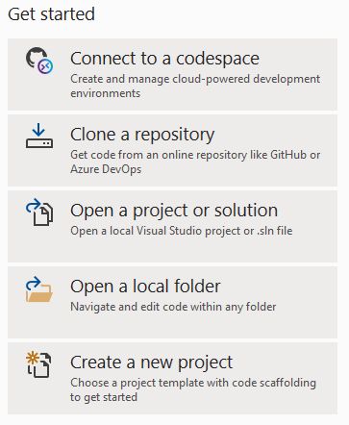
Create C# application in Visual Studio
Create a new Project from the visual studio 2019

Slide 4
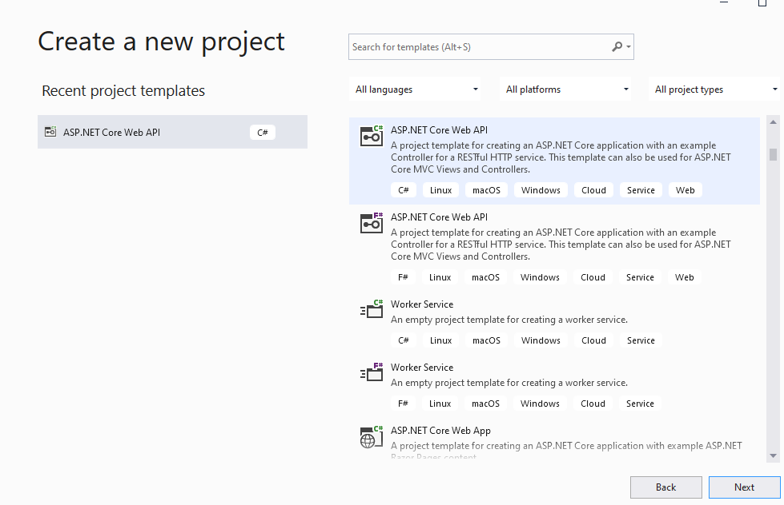
Create a New Project selecting ASP.NET Core Web API

Slide 5
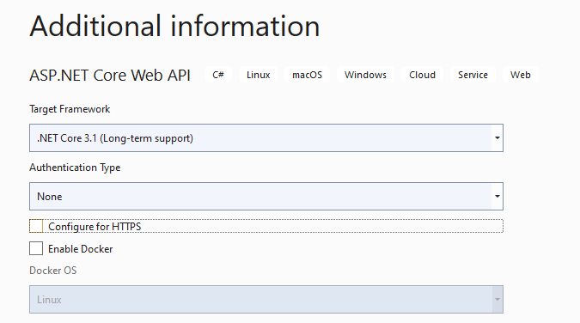
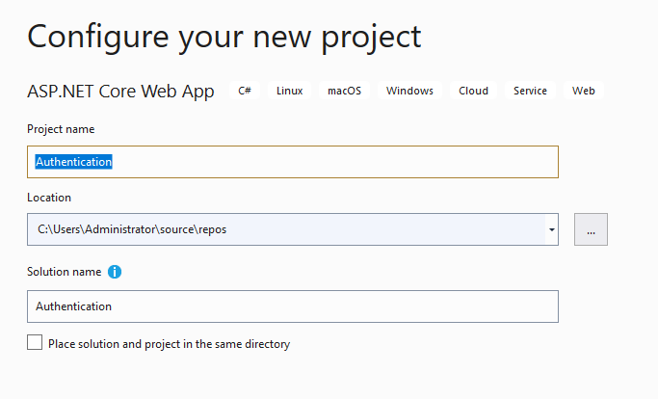
CONFIGURE THE PROJECT
Add up the Project name as :Authentication
Use the .NET Core 3.1 in Target Framework
Select the Loaction to save the Project
Uncheck Configure for HTTPS checkbox

Slide 6
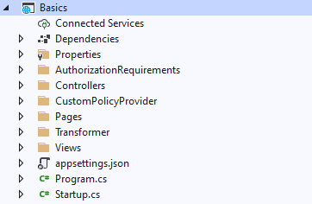
Project Created with default fields will be opened, following are the files which will be added up by default
Programs.cs file will be added
Startup.cs file will be added
LaunchSettings.json file will be added
For passing the authorisation and authentication , we will be adding up more folders in the Basics Project
Need to follow up the same structure so to have a Basic Home Page

Slide 7
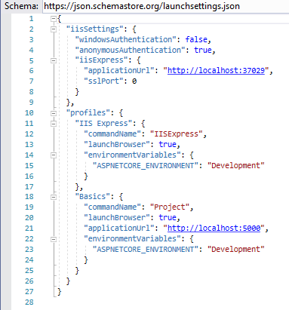
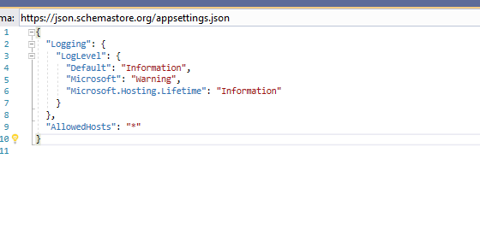
Start adding up the Code in the classes, controllers and cshtml
Create a class: AppSettings.cs in Newly created Folder named as Basics
FILE NAME : launchsettings.json
Add up the schema to give the commands to open the browser and provide the URL

Slide 8
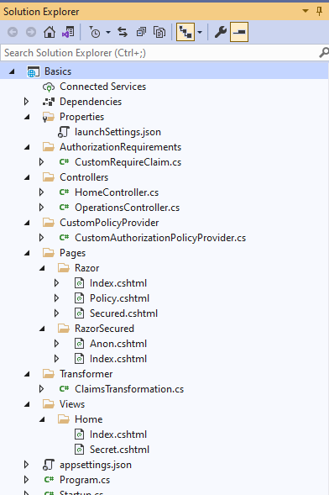
Follow structure to create files

Slide 9
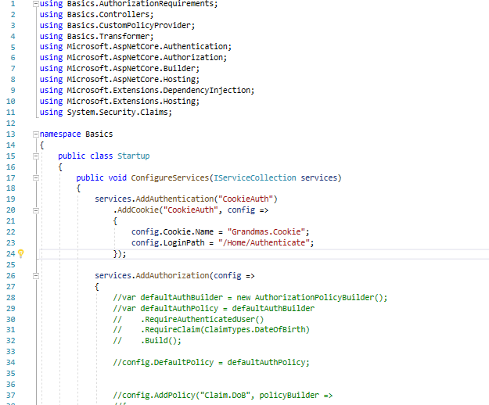
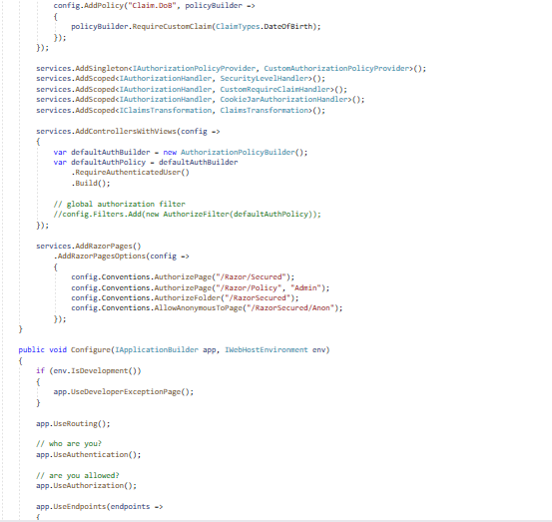
Update a class Startup. An existing class
Look at the Routes that to be access that which end point is going to be used
End point is going to be the main functionality here

Slide 10
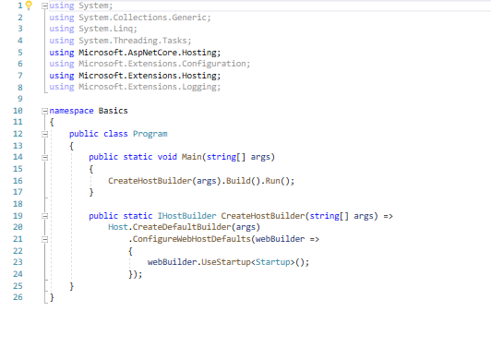
Update a class Program. An existing class

Slide 11

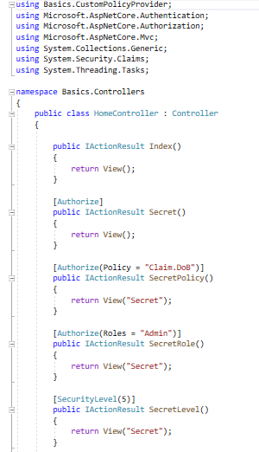
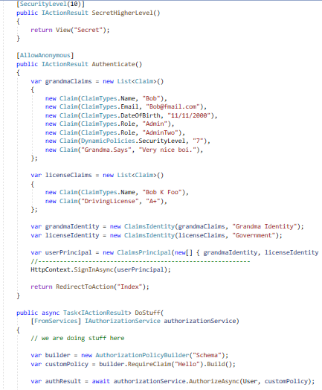
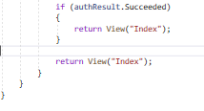
Need to add class files in Controllers
HomeControllers.cas
First Controller
Create a public Index
This will be the Home page
A Secret page will be added up here
And Authenticate to guard the secret data

Slide 12
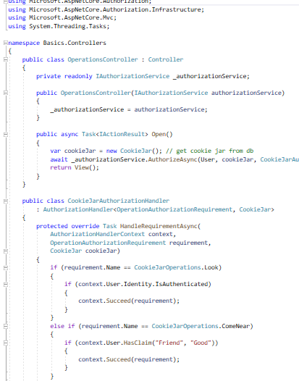
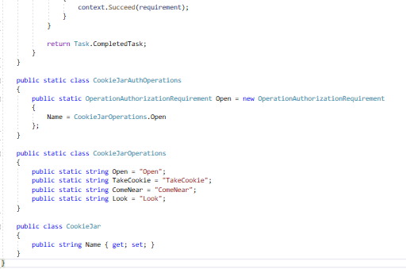
Need to add class files in Controllers
OperationsController.cs

Slide 13
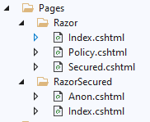

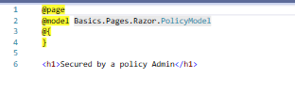



Need to add cshtml files in Razor and RazorSecured Folders under the Pages folder
Index.cshtml
Policy.cshtml
We will Run the page , it will show Error no data 404
Once with specified the Controllers and Authentication, data can be accessible
Anon.cshtml
Secured.cshtml
Index.cshtml

Slide 14
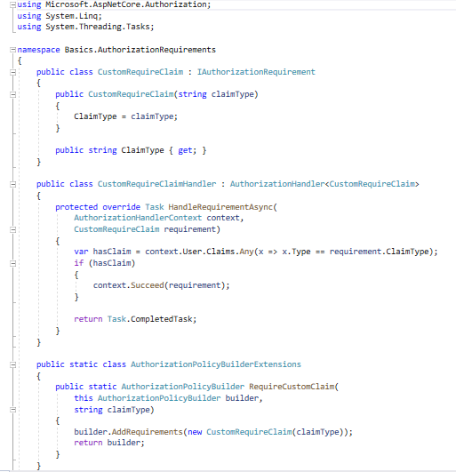

Basic Authorization Requirements

Slide 15
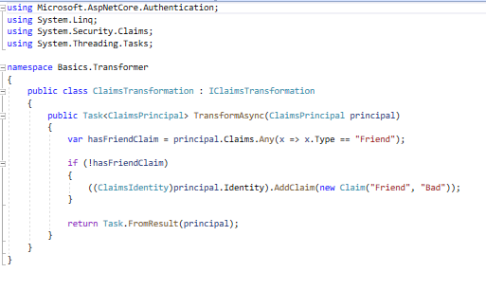

Basic Claim Transformation

Slide 16
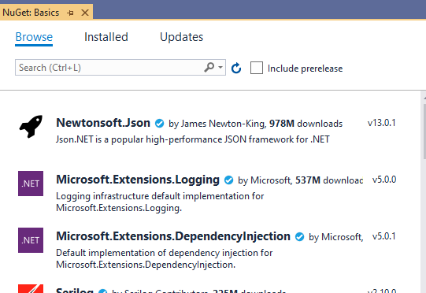
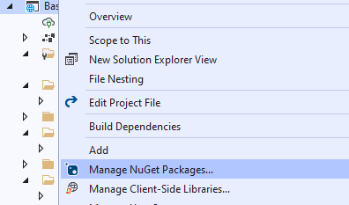
If there are errors in your code, check and install/update the packages,which included the NuGet Package

Slide 17

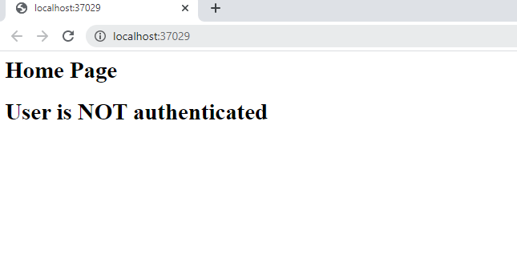
Run the Project using Run button
Copy this Local Host URL, it will be used later to check the authentication

Slide 18
Add a new Clean Project with a name IDENTITYEXAMPLE

Slide 19
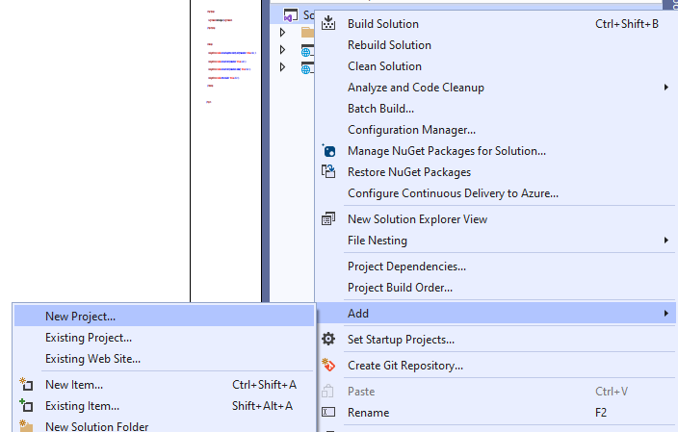
Create another Project with the name Identity Example
Use the same initial steps which were selected in making the Initial Project

Slide 20
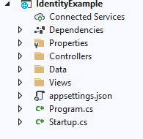
Project Created with default fields will be opened, following are the files which will be added up by default
Programs.cs file will be added
Startup.cs file will be added
LaunchSettings.json file will be added
For passing the authorisation and authentication , we will be adding up more folders in the Basics Project
Need to add up the packages to give the in memory for the database

Slide 21
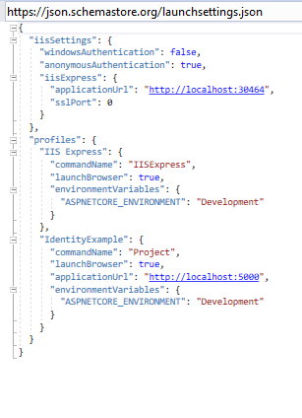
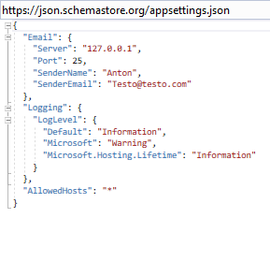
Start adding up the Code in the classes, controllers and cshtml
Create a class: AppSettings.cs in Newly created Folder named as Basics
FILE NAME : launchsettings.json
Add up the schema to give the commands to open the browser and provide the URL

Slide 22
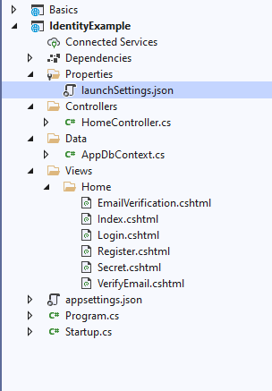
Follow structure to create files

Slide 23
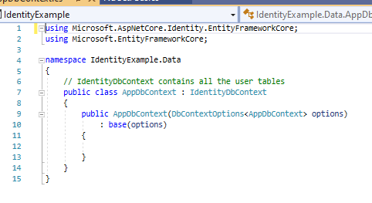

AppDBContext.cs file in Data folder
Data folder will be created
DB context is where the tables get registed

Slide 24
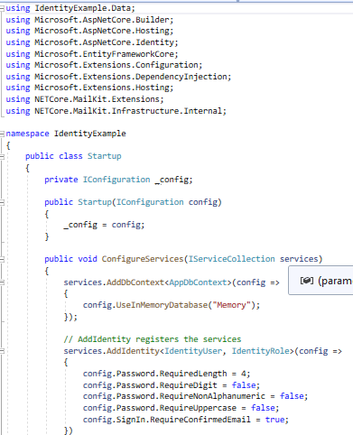
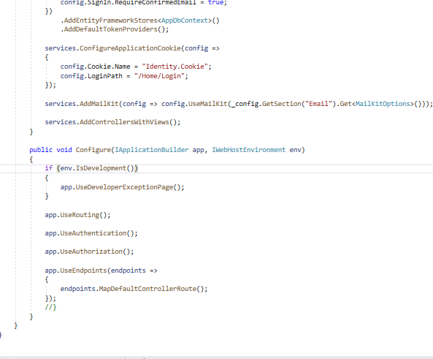
Update a class Startup. An existing class
Here we need to add the AppDB Context
In memory database will be used here

Slide 25
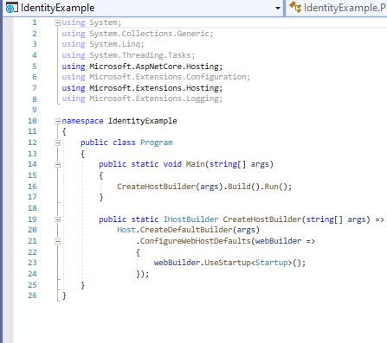
Update a class Program. An existing class

Slide 26

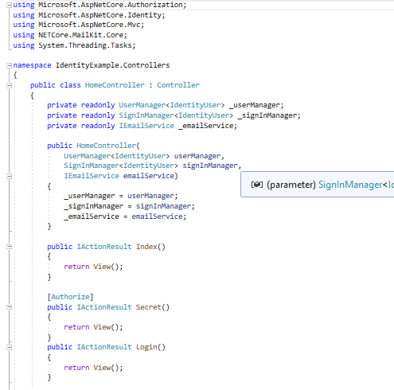
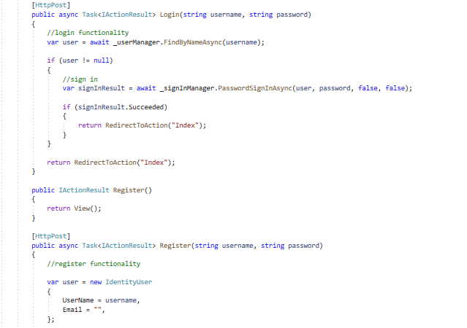
Need to add class files in Controllers
HomeControllers.cas

Slide 27
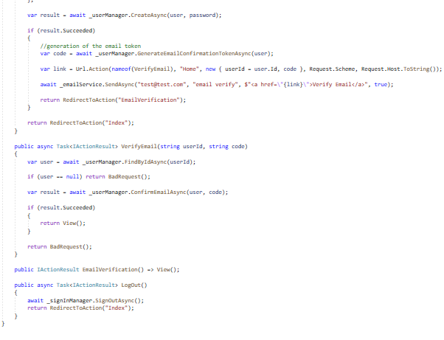
HomeControllers.cas (Continued)
An identity user will be created here
This will be created synchronus

Slide 28
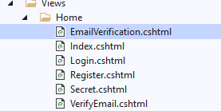

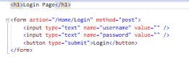




Need to add cshtml files Home Folder under the Views folder
Index.cshtml
Login.cshtml
Secret.cshtml
Register.cshtml
VerifyEmail.cshtml
EmailVerification.cshtml

Slide 29
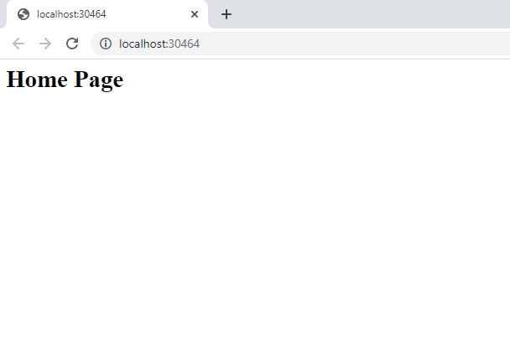
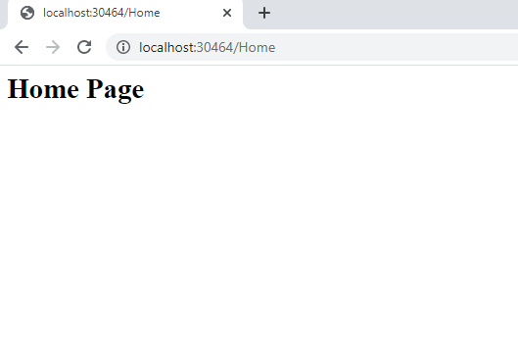
Run the Project using Run button
Add up /home to check whether user is able to reach the Home page
Copy this Local Host URL, it will be used later to check the authentication

Slide 30
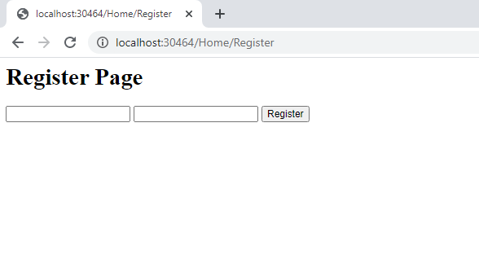
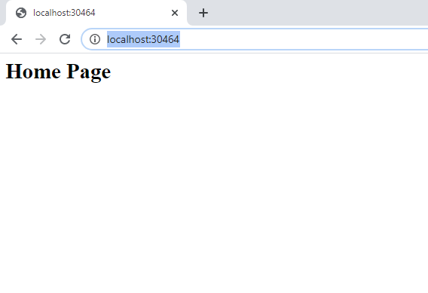
Add up /home/Register to check whether user is able to reach the Register page
Enter the details in the fields and check after the hitting Register, user should be able to redirected to Home page

Slide 31
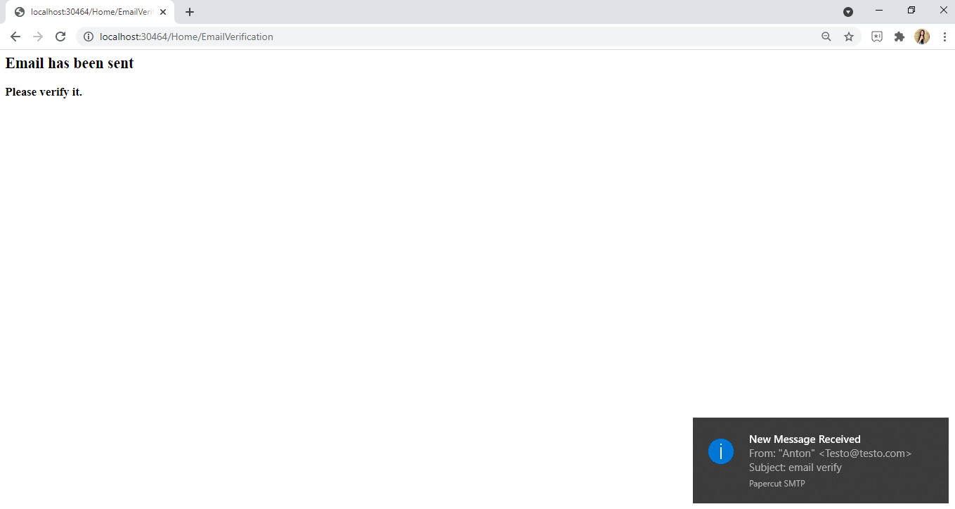
Papercut server at our local host to Email verification
Redirect to Home page and Register , once the user is register following screen will be shown up

Slide 32
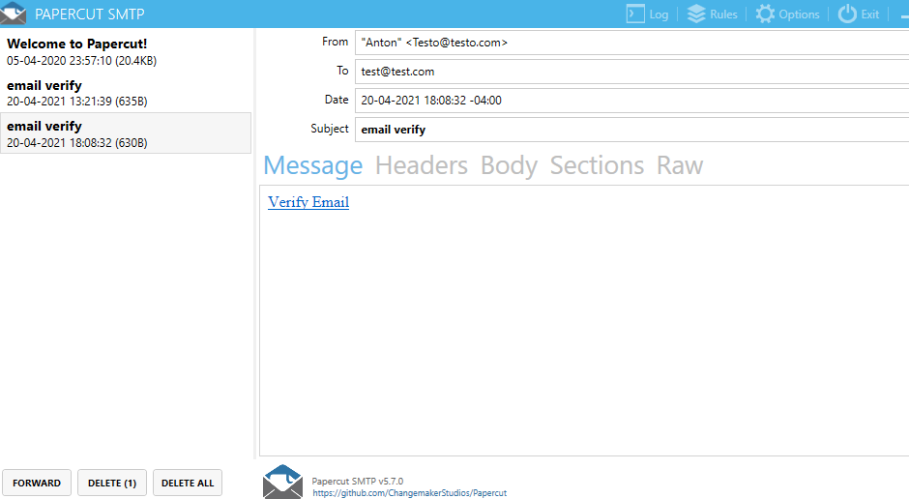
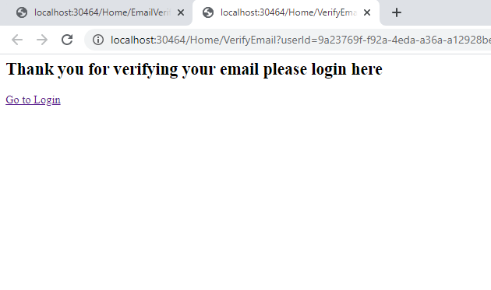
Click on Verify Email in Paper Cut.
User will be redirected to new tab which states that thankyou for verifying

Slide 33

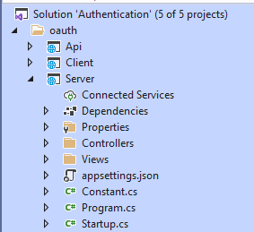
Create 3 new projects
Create a New Project selecting ASP.NET Core Web API
Project Created with default fields will be opened, following are the files which will be added up by default
Programs.cs file will be added
Startup.cs file will be added
LaunchSettings.json file will be added
Need to follow up the same structure

Slide 34
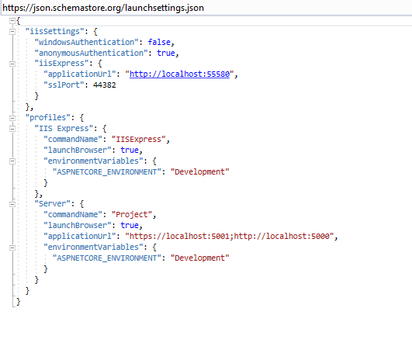
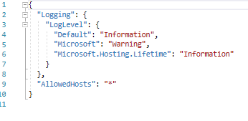
Start adding up the Code in the classes, controllers and cshtml
Create a class: AppSettings.cs in Newly created Folder named as oauth
FILE NAME : launchsettings.json
Add up the schema to give the commands to open the browser and provide the URL

Slide 35
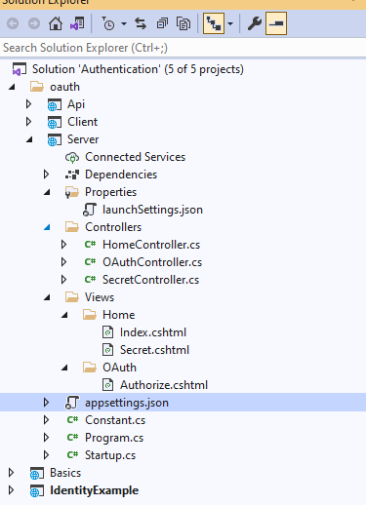
Follow structure to create files

Slide 36
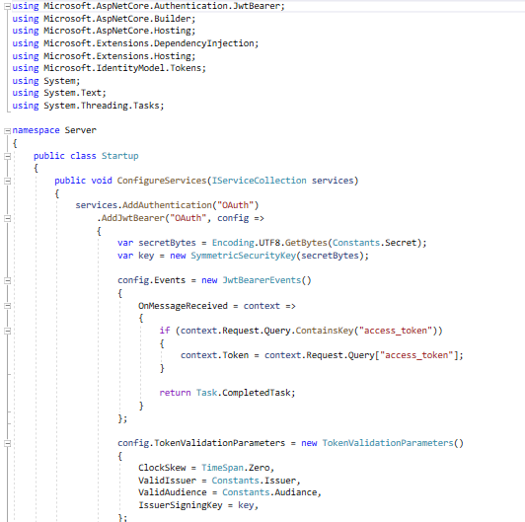
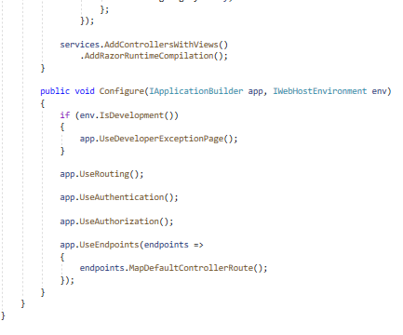
Update a class Startup. An existing class

Slide 37

Update a class Program. An existing class

Slide 38



Need to add class files in Controllers
HomeControllers.cs

Slide 39


Need to add class files in Controllers
QAuthControllers.cs

Slide 40

Need to add class files in Controllers
SecretControllers.cs

Slide 41




Need to add cshtml files Home Folder under the Views folder
Index.cshtml
Secret.cshtml
Authorize.cshtml

Slide 42


Run the Project using Run button

Slide 43
Add up /home/Secret to check whether user is able to reach the secret content
After submitting the user will be redirected too client Secret Page

Slide 44
Make a recommendation on which choice of Authentication method (OAuth, OpenId, or other) is best for API security
Oauth would be highly recommended as if we are sharing the information to a third system or from a client side to a Business partner , Oauth will be one of the best suitable Authentication method which should be used

Slide 45
REFERENCES LINK
Credits : Ms Nital Shah for sharing the knowledge and to set up an environment for sharing the data with security
Links : https://www.youtube.com/playlist?list=PLOeFnOV9YBa7dnrjpOG6lMpcyd7Wn7E8V
: Class learning sections , material provided in class

Slide 46
VIDEO LINK
https://youtu.be/IDhqTMfaNGk

Slide 47
THANKYOU

